Slide 1
College Prep App
Micah Andres
(Name of the application is still in progress)

Slide 2
What is the application?
The full-stack application is designed to focus on high-school students that is preparing the transition to a university and enrolling in their desired curriculum by giving them the vital resources and data that will equip them to be effective & competitive university/college applicants.

Slide 3
Target Population:
Highschool students specifically looking at universities in only North America.

Slide 4
Potential API Databases:
DATA.GOV
- College Scoreboard API:
The College Scorecard is designed to increase transparency, putting the power in the hands of the public — from those choosing colleges to those improving college quality — to see how well different schools are serving their students.
LINK:
https://collegescorecard.ed.gov/data/documentation/

Slide 5
How would the website look like?
Primarily there would be a resources link that would be broken down:
Resources link:
A. Test Preparation:
-ACT/SAT prep
-Test preparation
-Schedule test
B. Resume Guide:
-How to make an effective resume
C. College Interview Guide:
-How to be an effective speaker
-How to nail your interview
D. Financial Aid:
-FAFSA
-Private Loans
E. **There should be a link that they can use that will guide them to look for their college of choice and see the following requirements of what they need in order to get in.

Slide 6
User Story
As a user of this application, I can easily obtain information on how to register for my ACT/SAT testing and know what particular scores I need to get to be granted into the college/university of my choice. I would know how to register for financial aid as well as conducting the sequential steps (College Application Essay/Interview) to successfully enroll in my desired program/curriculum.

Slide 7
MySQL Table
Primarily Have a “student tracker”
Upon entering the application, the user must enter a username and password. This will be used to track the user’s progress.
On the home-screen there should be a tracker where it would be like the following:
Student “X” (| Where X is defined as the username), College Application and Preparation Progress:
SAT/ACT – Registered for test?
YES OR NO
Did Student “X” looked into the possibility of financial aid?
YES OR NO
Did Student “X” register and apply for Financial aid?
YES OR NO
Did Student “X” receive confirmation of financial aid?
YES OR NO
Potentially there could be more to the table, but due to the time and progress of producing this application I will be focusing on these.

Slide 8
Nice-To-Haves
This full-stack application has the potential to become commercially viable for schools to use for their students.
Here are the following Nice-To-Haves to be considered for future-development:
Implement International Schools
Student took ACTs/SATS shows potential schools that the student can get into based upon what they scored.
Implement a Career/Job Curriculum. Rather than resorting of looking at the colleges/university’s requirements, Utilizing a search for a particular job can be lined with the potential universities/colleges that specialize in this area along with showing the following curricula that the student must follow in order to successfully be an employee competitive applicant upon university graduation.
Establish a variety of media queries to have the application mostly mobile responsive for both Android and iOS. (Set as priority)
Create an avatar when user signs up. (I.e. A plant). As the user checks everything off the “To-Do-List” (Sign up for the ACTs/SATs, Register for Financial Aid, Practice University Mock Interviews, Prepare University Mock Essays), the plant will grow from a single stem to a large tree?

Slide 9
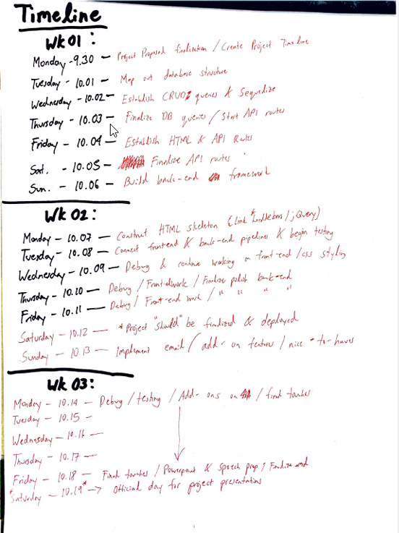
Rough Sketch of Project 02 Timeline

